Slide 1
Laptop Price Analysis and Prediction
An analytical report on laptop pricing trends and stock insights
Presented By- Varun Malhotra

Slide 2
CONTENTS
Objective
Data Overview
Dashboard Components
Tools and Technologies Used
Key Insights
Business Impact
Future Improvements

Slide 3
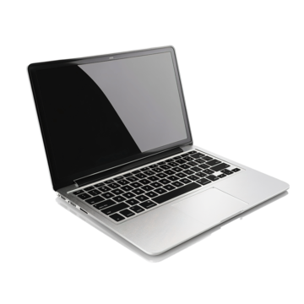

Objective
The primary goal of this project is to analyze laptop pricing trends, identify stock distributions across various configurations, and enable average price prediction based on key features using an interactive dashboard.

Slide 4
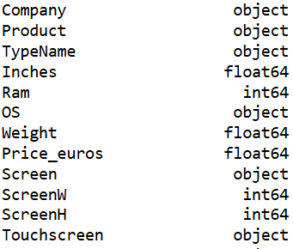
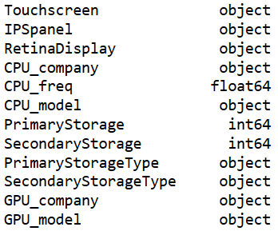


DATA OVERVIEW
The dataset includes detailed information about various laptop models from multiple brands with different specs, encompassing:

Slide 5

DASHBOARD COMPONENTS

Slide 6
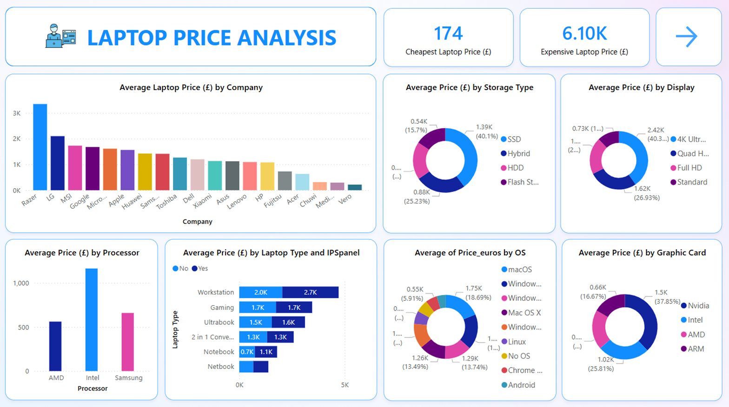
Laptop Price Analysis
Key insights visualized:
Average Laptop Price by Company:
Razer, LG, and MSI lead with the highest average prices.
Brands like Lenovo, HP, and Dell are more affordable on average.
Processor and GPU Pricing:
Intel CPUs and Nvidia GPUs result in higher average prices.
AMD processors offer more affordable configurations.

Slide 7

Laptop Type and IPS Panel:
Workstations and Gaming laptops have the highest average prices.
IPS panels consistently increase the average price across all types
OS Comparison:
macOS and Windows 10 Home editions are more expensive.
Linux and Chrome OS-based devices are on the budget-friendly end.
Average Price by Storage Type:
SSD-based laptops dominate the mid-to-high price segment
HDDs and Hybrid storage tend to be more affordable.
Average Price by Display Resolution:
4K Ultra-HD laptops are the most expensive, followed by Quad HD and Full HD.
Standard resolution laptops are the least expensive.

Slide 8
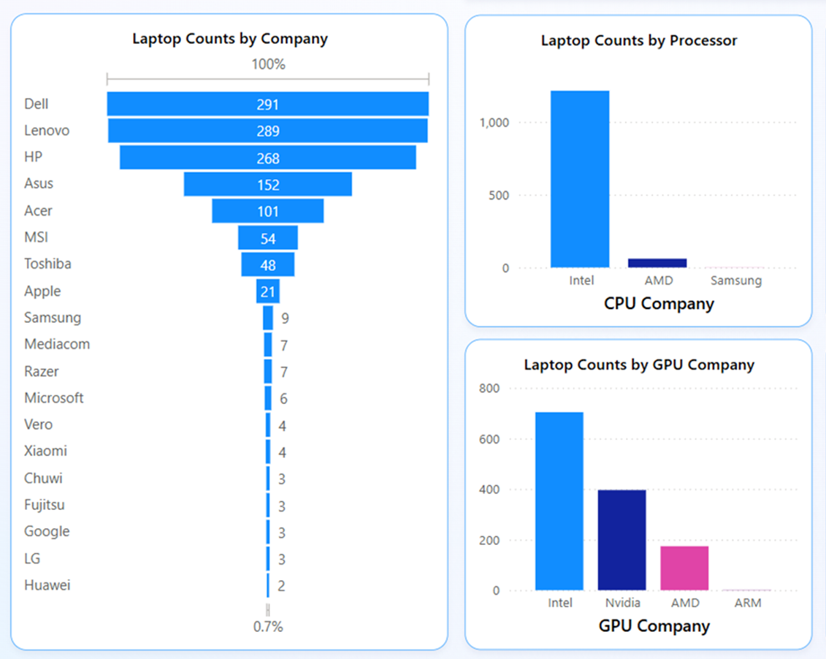
Laptop Stock Analysis
Key metrics shown:
Laptop Counts by Company:
Dell, Lenovo, and HP lead in inventory count.
Apple and premium brands like Razer and LG have limited stock.
CPU/GPU Distribution:
Intel CPUs are dominant in the market (over 1000 units).
Nvidia is the second most common GPU vendor after Intel integrated graphics.
Top Processors in Stock:
Core i5 7200U is the most stocked processor.
HD Graphics 620 is the most common GPU.

Slide 9
Laptop Price Analysis Dashboard Page-1/3

Slide 10

Laptop Price Analysis Dashboard Page-2/3

Slide 11
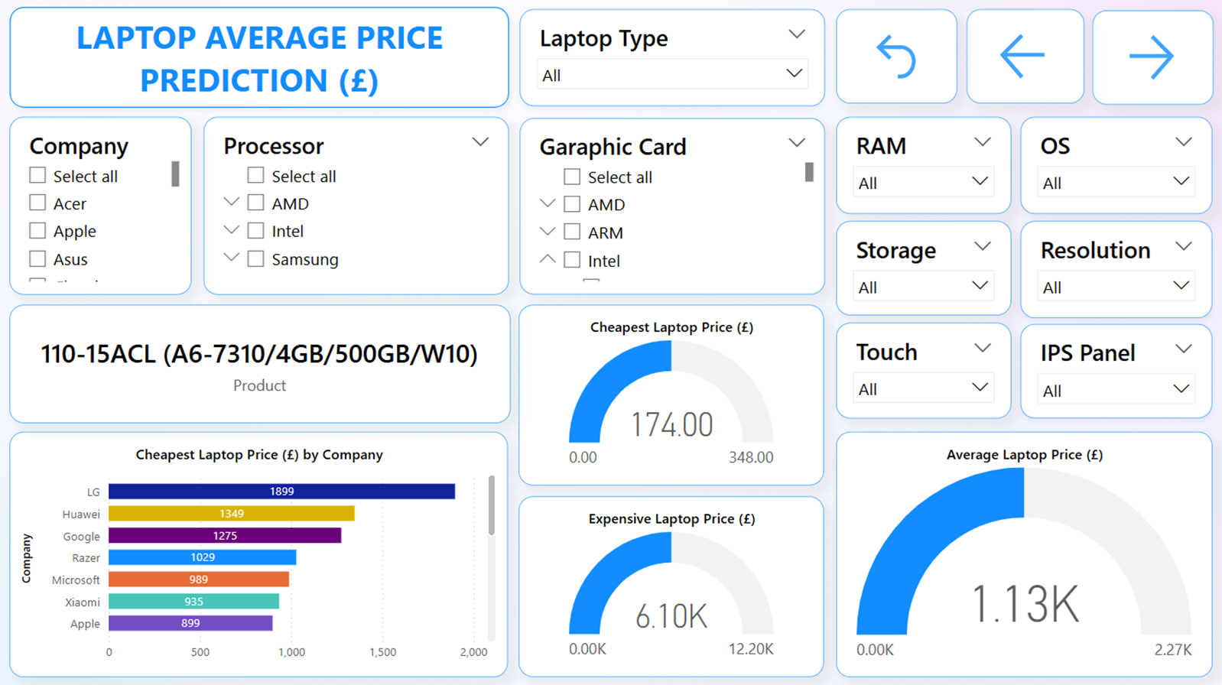
Laptop Price Analysis Dashboard Page-3/3

Slide 12
Laptop Price Prediction
An interactive prediction model helps estimate average price based on filters
User Inputs:
Brand, Processor, GPU, RAM, Storage, Resolution, OS, Touch/IPS.
Output:
Displays Cheapest, Most Expensive, and Average laptop prices in real-time.
Shows matching product name when filtered down to exact specs.
Overall Market:
Average Laptop Price: £1,130
Price Range: £174 to £6,100

Slide 13
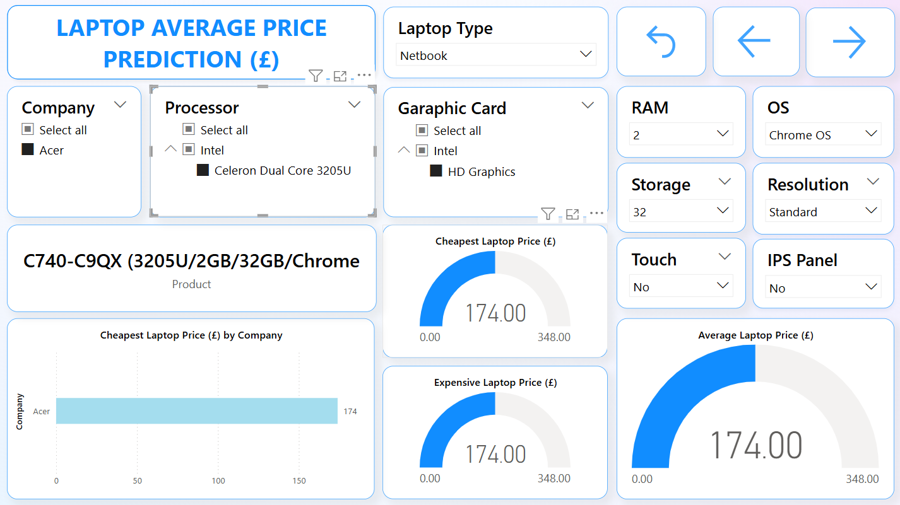
Filtered Price Prediction
Upon applying all the filters (such as Acer Netbook featuring Intel HD Graphics, 2GB RAM, and 32GB storage), the average price comes to £174.

Slide 14




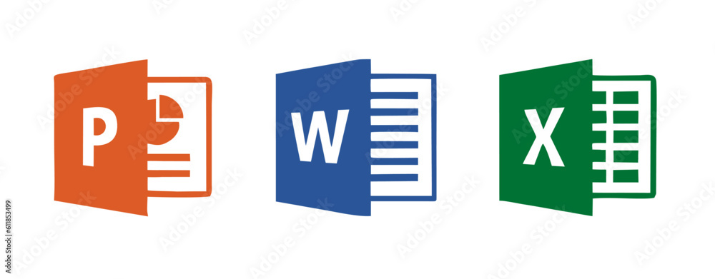
Tools & Technologies Used

Slide 15
Key Insights
Business Impact
This analysis and prediction system can help:
Retailers optimize pricing strategies.
Customers filter and find best-value laptops.
Manufacturers understand market competition and feature demand.
Future Improvements
Integrate real-time price updates via APIs.
Include user ratings and performance benchmarks.
Add forecasting model for upcoming price trends.
SSDs and IPS panels contribute significantly to price increases.
Brand reputation (e.g., Apple, Razer) drives premium pricing.
The most common configurations are mid-range Intel i5 laptops with integrated Intel graphics.
High display resolution and GPU-based devices (Nvidia, 4K) are niche but costly.

Slide 16


